Slide 1

Something about Containers
Rob Sewell @sqldbawithbeard https://sqldbawithAbeard.com

Slide 2
speaker questionnaire
Name : Rob (although Chrissy calls me Beard ☺ )
Occupation : DBA, Automator, Do-er, Trainer, DevOpser!
Available for hire ☺ - RobSewell.info
Interests : PowerShell, Automation And SQL (PaaS geddit?)
Interesting Fact : Beard. (Still) Plays Cricket, Flies Drone
Speaker : PsConfEU, PsConfAsia, PSSaturdays, PSMondays, User Groups PowerShell and SQL
Community : PowerShell VG, PowerShell Conference EU Organiser, PSDayUK Organiser, SQL South West , SQL Sat Exeter , dbatools, dbachecks, MVP

Slide 3
TODAY’s TO DO LIST
GET UP
Drink Coffee
Learn Loads at Polar Conf
Create Continuous Delivery Process for Delivering Modules to the PowerShell Gallery
Appropriate Liquid

Slide 4
Continuous Delivery

Slide 5
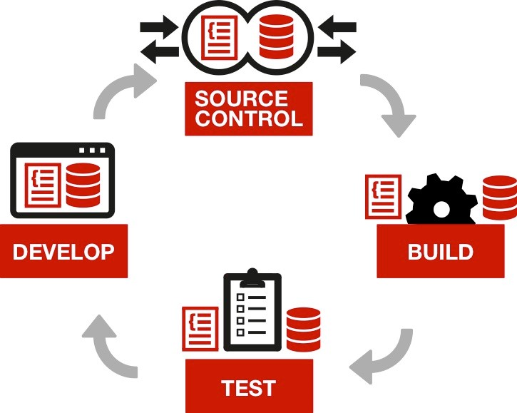
Continuous Integration

Slide 6
Azure Container Registry -ACR
Private Container registry
https://kubernetes.io/docs/concepts/overview/what-is-kubernetes/

Slide 7
Azure Container Registry -ACR
Private Container registry
Create one using Azure CLI
az acr create --resource-group beardkubes --name
beardacr --location westeurope --sku Basic
--admin-enabled

Slide 8
Build a Docker Image
Get the latest SQL Server Image
docker pull microsoft/mssql-server-linux:latest
Create Container and mount volume to host
docker run -d -p 15788:1433 --name 2017 -v C:\MSSQL\BACKUP:/var/opt/mssql/data/backup -e SA_PASSWORD=StupidPassw0rd -e ACCEPT_EULA=Y microsoft/mssql-server-linux

Slide 9
Prepare the image
Restore the database onto the image
$restoreDbaDatabaseSplat = @{
SqlCredential = $cred
Path = '/var/opt/mssql/data/backup/BACKUPFILE.bak'
SqlInstance = 'localhost,15788'
useDestinationDefaultDirectories = $true
}
Restore-DbaDatabase @restoreDbaDatabaseSplat
dbatools.io

Slide 10
Push to the ACR
Stop the container
Docker stop 2017
Create the image
Docker commit 2017 bearddevimage

Slide 11
Push to the ACR
Login to ACR
az acr login --name beardacr
List the server name
az acr list --resource-group beardkubes --query "[].{acrLoginServer:loginServer}" --output table

Slide 12
Push to the ACR
Tag the image
docker tag bearddevimage beardacr.azurecr.io/bearddevimage:latest
Push the image to ACR
docker push beardacr.azurecr.io/bearddevimage:latest

Slide 13
Now we are ready
We have our Production database in a container which we can spin up in very small amount of time.
Our developers could use this for doing their development
We can build it into our Test process so that we know we are always using the latest version of our production database and adding the artifacts for our release

Slide 14
Kubernetes
The name Kubernetes originates from Greek, meaning helmsman or pilot, and is the root of governor and cybernetic. K8s is an abbreviation derived by replacing the 8 letters “ubernete” with “8”.
https://kubernetes.io/docs/concepts/overview/what-is-kubernetes/

Slide 15
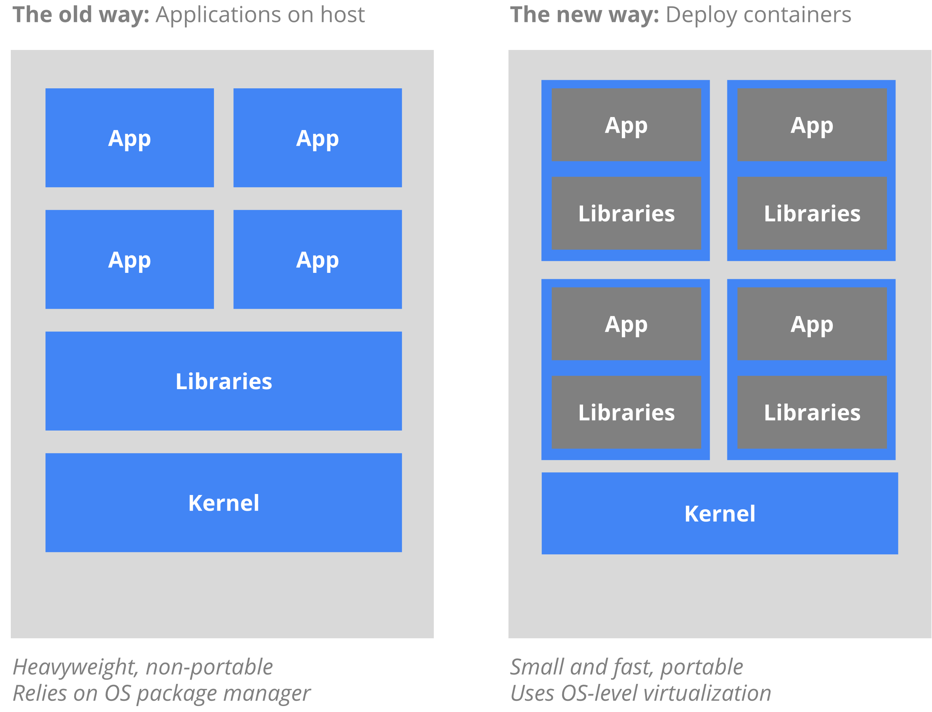
Kubernetes
https://kubernetes.io/docs/concepts/overview/what-is-kubernetes/

Slide 16

Just like Jimi Hendrix …
We love to get feedback
Please complete the
session feedback forms

